Slide 1







System analysis & design
Information Security & Cybercrim
E-Commerce

Slide 2



Nasima Akter
ID:221-15-4755

Slide 3









Computer Applications in the Society
Internet Based Applications in the Society
Education/Research,
Government,
Finance,
Healthcare,
Publishing, ➢
Industry,
Personal Communication

Slide 4
Malware
(malicious software)
Viruses
Worms
Trojan horses
SQL injection attacks
Spyware
Key loggerss

Slide 5

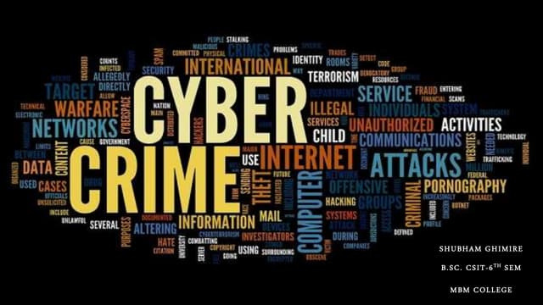

What are Cyber Crime?
Cybercrime is when bad guys use computers to do bad things .
They might sneak into Your computer and take Your things.
Cybercrime is like a sneaky digital thief .

Slide 6
TYPES OF CYBERCRIME
1. Online Scams
2. Hacking
3. Identity Theft
4. Cyberbullying
5. Malware Attacks

Slide 7


Types of Network Security
Information Security
Access control
Antivirus and antimalware software
Application security
Data loss prevention
Email security
Mobile device security
Security information and event management
Physical Security
Network Security
Data Security

Slide 8
How can we protect our-self ?
Use strong passwords that are hard to guess .
Don't click on links or open emails from people you don't know .
Keep Your computer AND apps updated to stay safe from viruses .

Slide 9

Jannatul Ferdous Riva
ID:221-15-4928

Slide 10

E-Commcrce
E-commerce is the process of buying and selling goods and services over the internet.

Slide 11
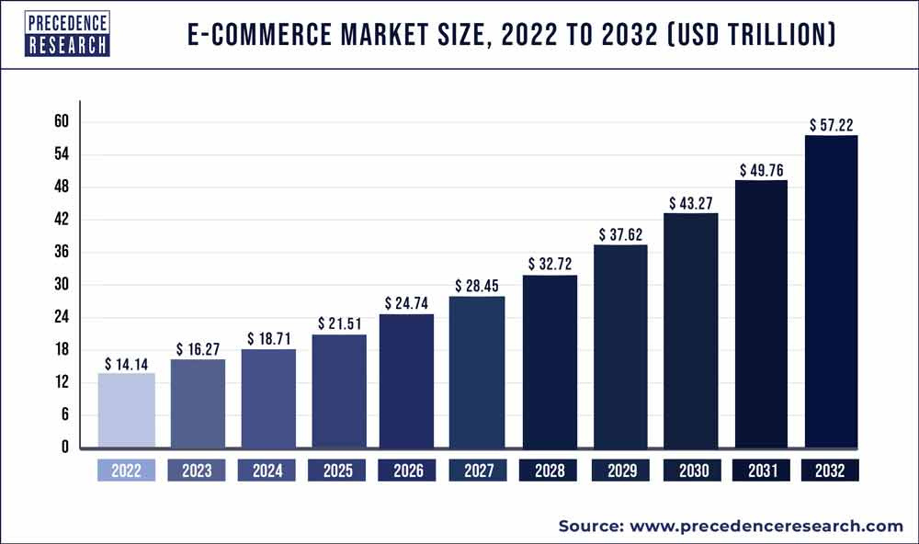
The Growth of E-Commerce
To Access our Exclusive Data Intelligence Tool with 15000+ Database, Visit: Precedence Statistics

Slide 12
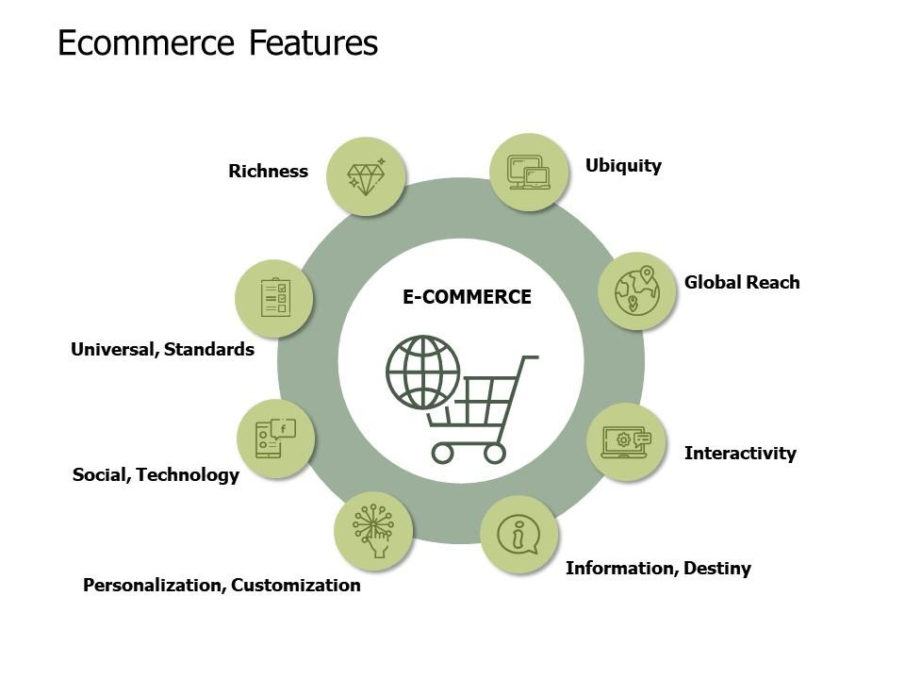
Features of
E-commerce technology

Slide 13
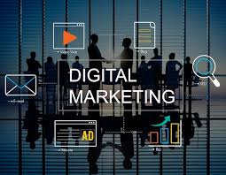
What is Digital Marketing?
Digital marketing is the use of the Internet,
mobile devices, social media, search engines,
and other channels to reach consumers.

Slide 14
Digital Marketing Channels
Website Marketing
Pay-Per-Click (PPC) Advertising
Content Marketing
Email Marketing
Social Media Marketing
Affiliate Marketing
Video Marketing
Search Engine Optimization (SEO)
Conversion Rate Optimization (CRO)

Slide 15
Types of Electronic Commerce
Business-to-business (B2B)
Business-to-consumer (B2C)
Consumer-to-consumer (C2C)
Consumer-to-Business (C2B)

Slide 16
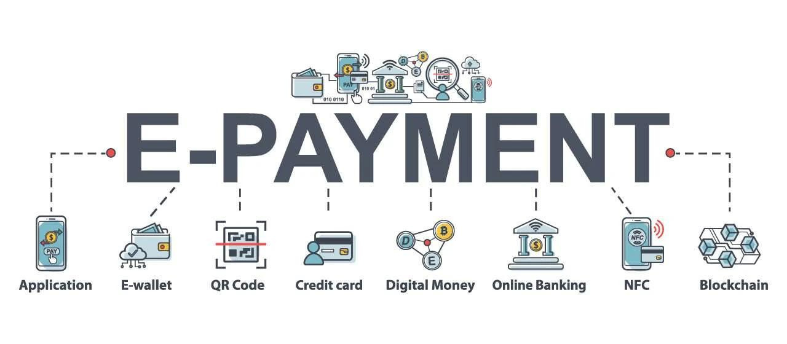
Types of electronic payment systems

Slide 17

Thank's For Watching

